Slide 1
Algorithms Club
Presented by: Ashish Uppala
09/27/2017

Slide 2
Today’s Agenda
Updated Schedule
Next week meeting tentative
Algorithms/fun puzzles starting the week after next (☺)
Overview of Graphs and Trees
Concepts from graph theory
Graph terminology
Graph representations
Breadth and Depth First Search

Slide 3
Graphs & Trees

Slide 4
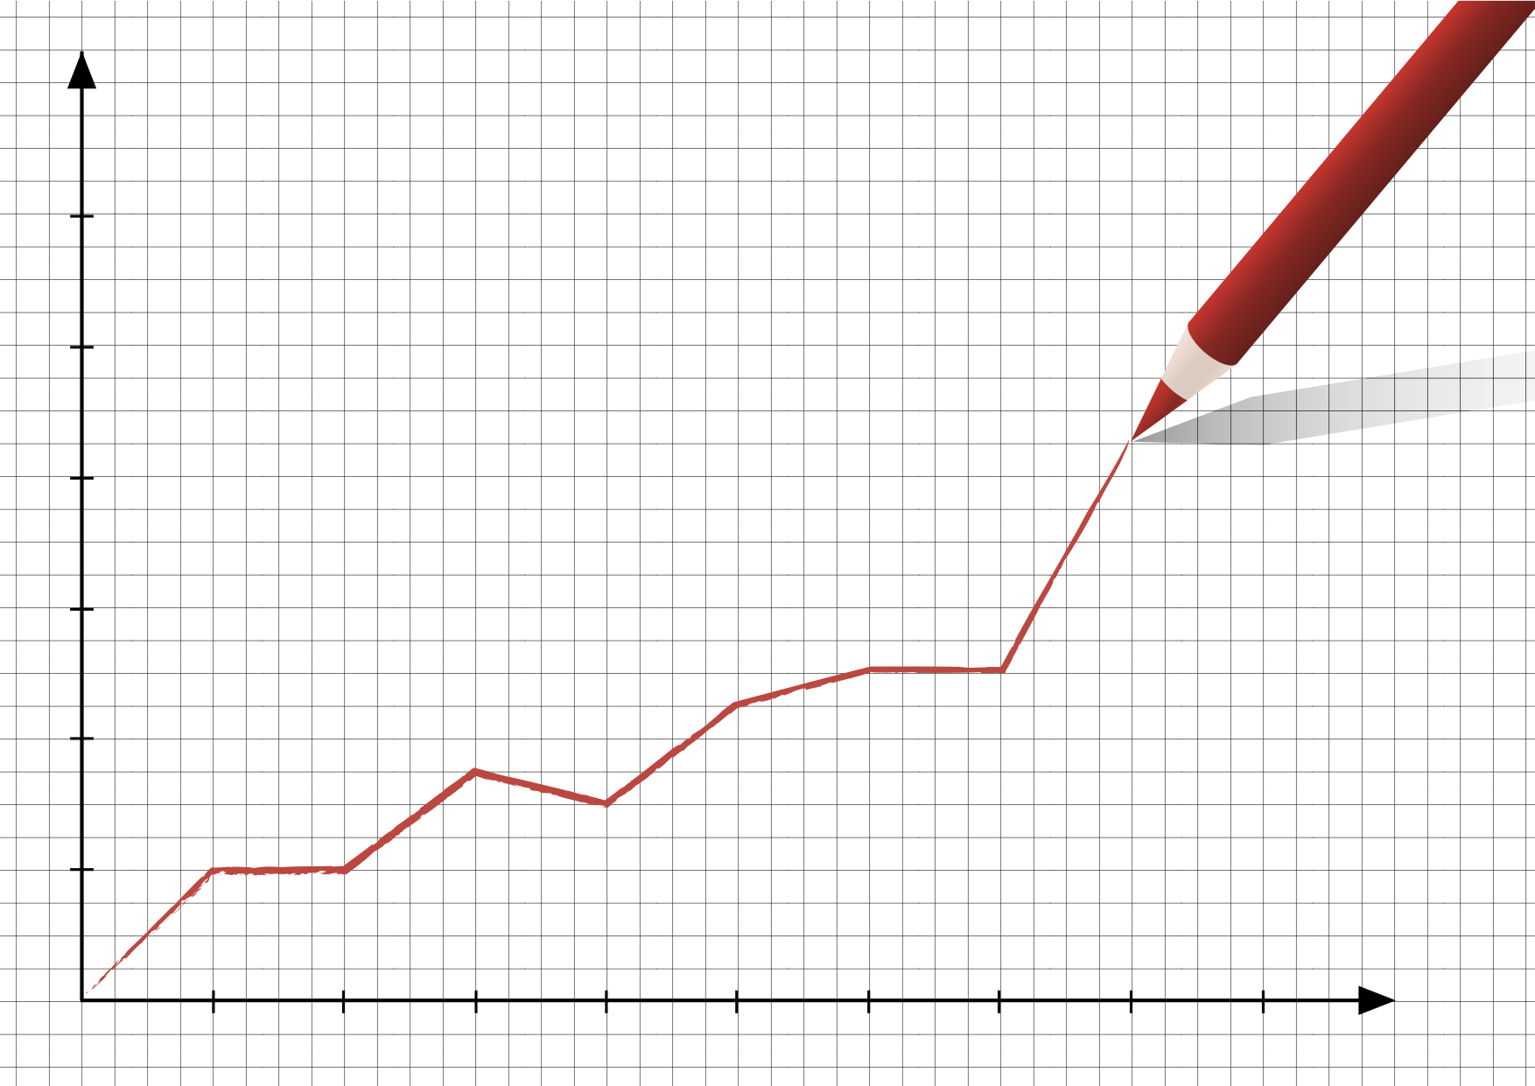
What are graphs?

Slide 5
What are graphs?

Slide 6
What are graphs?
A collection of nodes with edges between (some of) them.
*edges are also called vertices

Slide 7
What are graphs?
A collection of nodes with edges between (some of) them.
*edges are also called vertices
Sid
Ashish
Marc
Cat
Samee

Slide 8
What are graphs?
A collection of nodes with edges between (some of) them.
Sid
Undirected Graph
(No arrows; goes both ways)
Ashish
Marc
Cat
Samee

Slide 9
What are graphs?
What if not everyone knows each other?
Sid
Ashish
Marc
Schmitty
Cat
Samee

Slide 10
What are graphs?
Directed graphs have directed edges
Sid
Directed Graph
(Arrows; go one way)
Ashish
Marc
Schmitty
Cat
Samee

Slide 11
Graph terminology
Sometimes you can have a cycle
Sid
Cycle
When a path ends in a vertex it started with
Ashish
Marc
Schmitty
Cat
Samee

Slide 12
Graph terminology
We can give edges different weights
Sid
10
8
Weights
Values on an edge to represent metrics like cost, capacity, distance, similarity, etc.
Ashish
Marc
Schmitty
5
4
6
4
10
6
7
3
Cat
Samee
1
2

Slide 13
Graph terminology
An edge between two vertices is incident on the two vertices. The number of edges incident on a vertex is the degree of the vertex.
Sid
10
8
Degree
Number of edges incident on a vertex
Ashish
Marc
Schmitty
5
4
6
4
10
6
7
3
Cat
Samee
1
2

Slide 14
Graph terminology
Directed acyclic graph
Directed cyclic graph
Marc
Schmitty
Marc
Schmitty
Samee
Samee

Slide 15
Representing graphs
Sid
0
Ashish
Marc
4
1
Cat
Samee
3
2
Vertices can be numbered from 0 to N-1 where N is total # nodes

Slide 16
Representing graphs Edge lists
0
[ [0,1], [0,2], [0,3], [0, 4],
[1,2], [1,3], [1,4], [2,3], [2,4], [3,4] ]
4
1
3
2

Slide 17
Representing graphs Edge lists
0
[ [0,1], [0,2], [0,3], [0, 4],
[1,2], [1,3], [1,4], [2,3], [2,4], [3,4] ]
4
1
How long would it take to see if a specific edge (e.g. [0,4]) is in our graph?
How much space does this take?
3
2

Slide 18
Representing graphs Edge lists
0
[ [0,1], [0,2], [0,3], [0, 4],
[1,2], [1,3], [1,4], [2,3], [2,4], [3,4] ]
4
1
How long would it take to see if a specific edge (e.g. [0,4]) is in our graph?
How much space does this take?
Time complexity: O(M)
Space complexity: O(M)
3
2

Slide 19
Representing graphs Adjacency MATRIX
0
 | 0 | 1 | 2 | 3 | 4
0 | 0 | 1 | 1 | 1 | 1
1 | 1 | 0 | 1 | 1 | 1
2 | 1 | 1 | 0 | 1 | 1
3 | 1 | 1 | 1 | 0 | 1
4 | 1 | 1 | 1 | 1 | 0
4
1
3
2
[ [0, 1, 1, 1, 1],
[1, 0, 1, 1, 1],
[1, 1, 0, 1, 1],
[1, 1, 1, 0, 1],
[1, 1, 1, 1, 0] ]

Slide 20
Representing graphs Adjacency MATRIX
0
 | 0 | 1 | 2 | 3 | 4
0 | 0 | 1 | 1 | 1 | 1
1 | 1 | 0 | 1 | 1 | 1
2 | 1 | 1 | 0 | 1 | 1
3 | 1 | 1 | 1 | 0 | 1
4 | 1 | 1 | 1 | 1 | 0
4
1
3
2
[ [0, 1, 1, 1, 1],
[1, 0, 1, 1, 1],
[1, 1, 0, 1, 1],
[1, 1, 1, 0, 1],
[1, 1, 1, 1, 0] ]
Time complexity: O(1)
Space complexity: O(N^2)

Slide 21
Representing graphs Adjacency LIST
0
Intuition: For each vertex, store an array of the adjacent/neighboring nodes.
4
1
0
1
4
[ [1,4],
[0,2],
[1,3,4],
[2],
[0,2] ]
1
0
2
2
1
3
4
3
2
3
2
4
0
2

Slide 22
Representing graphs Adjacency LIST
0
Intuition: For each vertex, store an array of the adjacent/neighboring nodes.
4
1
0
1
4
[ [1,4],
[0,2],
[1,3,4],
[2],
[0,2] ]
1
0
2
2
1
3
4
3
2
3
2
4
0
2
Time complexity: O(d) //d = degree of vertex
Space complexity: O(2*E) → O(E) //E = # of edges

Slide 23
Representing graphs adjacency vs. edge lists
Adjacency List:
Time complexity: O(d) //d = degree of vertex
Space complexity: O(2*E) → O(E) //E = # of edges
Edge List:
Time complexity: O(M)
Space complexity: O(M)
ARE THEY THE SAME?

Slide 24
Big-O of Graph representations
Storage | Add Vertex | Add Edge | Query
O(|V| + |E|) | O(1) | O(1) | O(|V|)
O(|V|^2) | O(|V|^2) | O(1) | O(1)
V = #vertices (nodes)
E = #edges

Slide 25
Big-O of Graph representations
Storage | Add Vertex | Add Edge | Query
O(|V| + |E|) | O(1) | O(1) | O(|V|)
O(|V|^2) | O(|V|^2) | O(1) | O(1)
Adjacency List
Adjacency Matrix
V = #vertices (nodes)
E = #edges

Slide 26
TREES
0
Root node at the top
Root node has zero or more child nodes
Each child node has zero or more child nodes
… and so on
If each node has at most two children, then it’s a binary tree
Nodes with zero children are called leaf nodes
1
2
3
4
5
6

Slide 27
TREE Traversals
In-order:
Left child, current node, right child
0
1
2
3
4
5

Slide 28
TREE Traversals
In-order:
Left child, current node, right child
→ 3,1,4,0,2,5
0
1
2
3
4
5

Slide 29
TREE Traversals
In-order:
Left child, current node, right child
→ 3,1,4,0,2,5
Pre-order:
Current node, left child, right child
0
1
2
3
4
5

Slide 30
TREE Traversals
In-order:
Left child, current node, right child
→ 3,1,4,0,2,5
Pre-order:
Current node, left child, right child
→ 0,1,3,4,2,5
0
1
2
3
4
5

Slide 31
TREE Traversals
In-order:
Left child, current node, right child
→ 3,1,4,0,2,5
Pre-order:
Current node, left child, right child
→ 0,1,3,4,2,5
Post-order:
Left child, right child, current node
0
1
2
3
4
5

Slide 32
TREE Traversals
In-order:
Left child, current node, right child
→ 3,1,4,0,2,5
Pre-order:
Current node, left child, right child
→ 0,1,3,4,2,5
Post-order:
Left child, right child, current node
→ 3,4,1,2,5,0
0
1
2
3
4
5

Slide 33
Traversals
0
1
2
3
4
5
6

Slide 34
Traversals Breadth First Search (BFS)
Intuition
Start at the source (root) node
Go through each of its neighbors (children) before going onto their children.
0
1
2
3
4
5
6

Slide 35
Traversals DEPTH First Search (DFS)
Intuition
Start at the source (root) node
Fully go down the rabbit hole of each of your neighbor’s neighbors, before exploring each of your neighbors first.
0
1
2
3
4
5
6

Slide 36
Traversals Breadth First Search (BFS)
Intuition
Start at the source (root) node
Go through each of its neighbors (children) before going onto their children.
0
1
2
5
4
3

Slide 37
Traversals Breadth First Search (BFS)
Intuition
Start at the source (root) node
Go through each of its neighbors (children) before going onto their children.
0
1
2
5
4
3
What is the output of a BFS traversal of this graph?

Slide 38
Traversals Breadth First Search (BFS)
Intuition
Start at the source (root) node
Go through each of its neighbors (children) before going onto their children.
0
1
2
5
4
3
What is the output of a BFS traversal of this graph?
Discovered Processed
[ 0 ] []
[ 1,4,5 ] [ 0 ]
[ 4, 5, 3 ] [ 0, 1 ]
[ 5, 3 ] [ 0, 1, 4 ]
[ 3 ] [ 0, 1, 4, 5 ]
[ 2 ] [ 0, 1, 4, 5, 3 ]
[] [ 0, 1, 4, 5, 3, 2 ]

Slide 39
implementation Breadth First Search (BFS)
0
1
2
CODEALONG!
5
4
3

Slide 40
Traversals DEpth First Search (dFS)
Intuition
Start at the source (or arbitrary node)
Explore each branch completely before going to next branch.
0
1
2
5
4
3
What is the output of a DFS traversal of this graph?

Slide 41
Traversals Depth First Search (DFS)
Intuition
Start at the source (or arbitrary node)
Explore each branch completely before going to next branch.
0
1
2
5
4
3
What is the output of a DFS traversal of this graph?
Discovered Processed
[ 0 ] []
[ 5,4,1 ] [ 0 ]
[ 5,4, 3] [ 0, 1 ]
[ 5,4, 2 ] [ 0, 1, 3 ]
[ 5,4 ] [ 0, 1, 3, 2 ]
[ 5 ] [ 0, 1, 3, 2, 4 ]
[] [ 0, 1, 3, 2, 4, 5 ]
0
1
3
2
4
5

Slide 42
implementation DEPTH First Search (DFS)
0
1
2
CODEALONG!
5
4
3

Slide 43
tidbits
BFS is awesome for finding shortest path between two nodes in an unweighted graph.
BFS – think of queues and iterative implementation.
DFS is awesome for going through each node. Technically doable with either BFS/DFS though.
DFS – think of stacks/recursion.
For implementation, the way we track the processed nodes doesn’t matter. But the way we track the discovered nodes does.
With BFS, use a queue.
With DFS, use a stack.

Slide 44
Practice questions
Implement code for an in-order, pre-order, and post-order traversal of a binary tree.
Given a binary tree, find its minimum depth.
Given a binary tree and two values in the tree, find their lowest common ancestor.

Slide 45
Continued reading
The Algorithm Design Manual by Steven Skiena
http://jeshu.weebly.com/uploads/5/2/6/0/5260012/skiena-the_algorithm_design_manual.pdf

